Slide 1

Introduction
This report guides the Public Health Foundation (PHF) on the determining the practical application of a Telehealth and E-health to communities in Missouri.
The Public Health Foundation aims at improving public heath to ensure healthier communities.
Telehealth and E-health improves healthcare availability of healthcare even in areas of despair in the state of Missouri.
Notes:
As part of the Public Health Foundation’s strategy to improve access to healthcare for the rural population in the state of Missouri, establishing a Telehealth and E-health in the city of Greene would play a big role in improving the in the remote areas. While Missouri currently has an estimated 174 healthcare facilities, the following slides will prove the need for our foundation’s help in improving healthcare access to the individual’s in need.

Slide 2
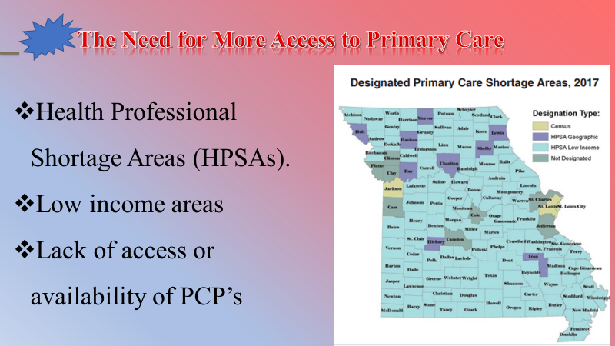
Notes:
The optimum way for us to view patients access or lack thereof to primary health care services is through analyzing projections of federally designated Health Professional Shortage Areas (HPSAs). The HPSAs in Missouri, according to our research we have discovered that the majority of HPSAs are due to low-income areas and to a lesser extent, Geographic HPSAs as seen on our image.
A Survey conducted in 2008 Medicare Payment Advisory Commission (MedPAC) established that an estimated 28 percent of Medicare beneficiaries who were without a primary care physician (PCP) stated that a their primary reason for not have a PCP was because of lack of access to a healthcare institute or lack of available PCP’s in their local area (Bodenheimer, & Pham, 2010).

Slide 3
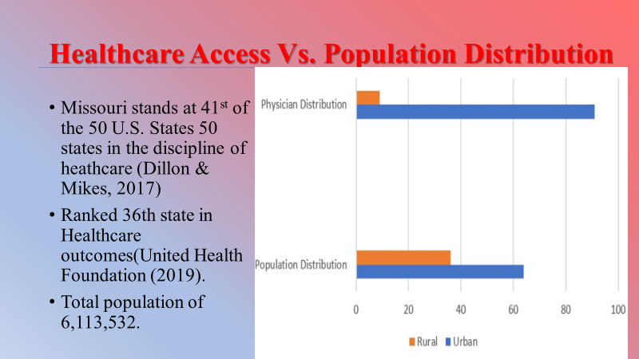
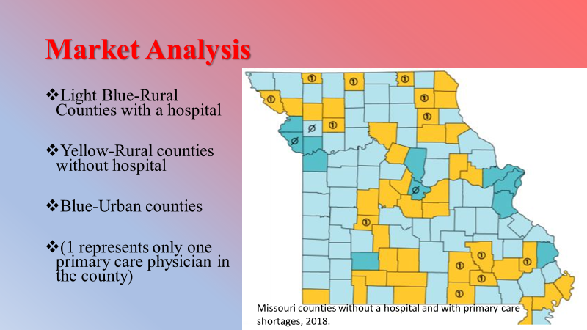

Notes:
Telemedicine answers the matter of accessibility and contact with PCP’s and other medical benefits that millions of individuals must deal with each year. PHF’s implementation of telemedicine wants to proactively provide new advancements in the remote supply of healthcare and healthcare professionals.
The difficulty of successfully enacting the use of of a telehealth service faces several barriers, initially at least. The barriers expected to be faced in the initiation of providing these new services rage from technological concerns to that of infrastructure. Furthermore, possible issues with legislation may prove tough at first (Van Dyke, 2014)
Telehealth supports long-distance health support, health care and health education by the use of communication technology such as the internet, streaming media, and wireless communications. Telehealth can help alleviate the challenges that high-need consumers in rural areas face in accessing health care. According to the Missouri Foundation of Health, many people have started using telehealth although there is still room for increases utilization for the population in the state.

Slide 4

Notes:
According to the University of Missouri –School of Medicine,
13.2% of adults(between the ages of 19 and 64) are uninsured.
The number of Preventable Hospitable admission per 100k patients is 4828 patients.
The obesity rate is 32.5% as compared to the average of 31.3% in the country.
Roughly 36% of Missouri's populations reside in rural areas whereas only 9% of the physicians of Missouri practice in these rural areas which creates a deficiency of physicians and hence hinders appropriate access to healthcare for the rural population in the state.

Slide 5
References
Anon. (2019). Health.mo.gov. Retrieved 29 July 2019, from https://health.mo.gov/living/families/ruralhealth/pdf/biennial2017.pdf
Bodenheimer, T., & Pham, H. H. (2010). Primary care: current problems and proposed solutions. Health Affairs, 29(5), 799-805.
Dillon, D. & Mikes, J. (2017). “The Status of Telemedicine in Missouri.”
Tuckson, R. V., Edmunds, M., & Hodgkins, M. L. (2017). Telehealth. New England Journal of Medicine, 377(16), 1585-1592.
United Health Foundation. (2019). America's Health Rankings. Retrieved 3 August 2019, from https://www.americashealthrankings.org/explore/annual/measure/Determinants/state/MO
MU School of Medicine. (2019). Medicine.missouri.edu. Retrieved 3 August 2019, from https://medicine.missouri.edu/offices-programs/missouri-telehealth-network
Van Dyk, L. (2014). A review of telehealth service implementation frameworks. International journal of environmental research and public health, 11(2), 1279-1298.

